Slide 1
DeepSoCFlow - Particle Transformer

Slide 2
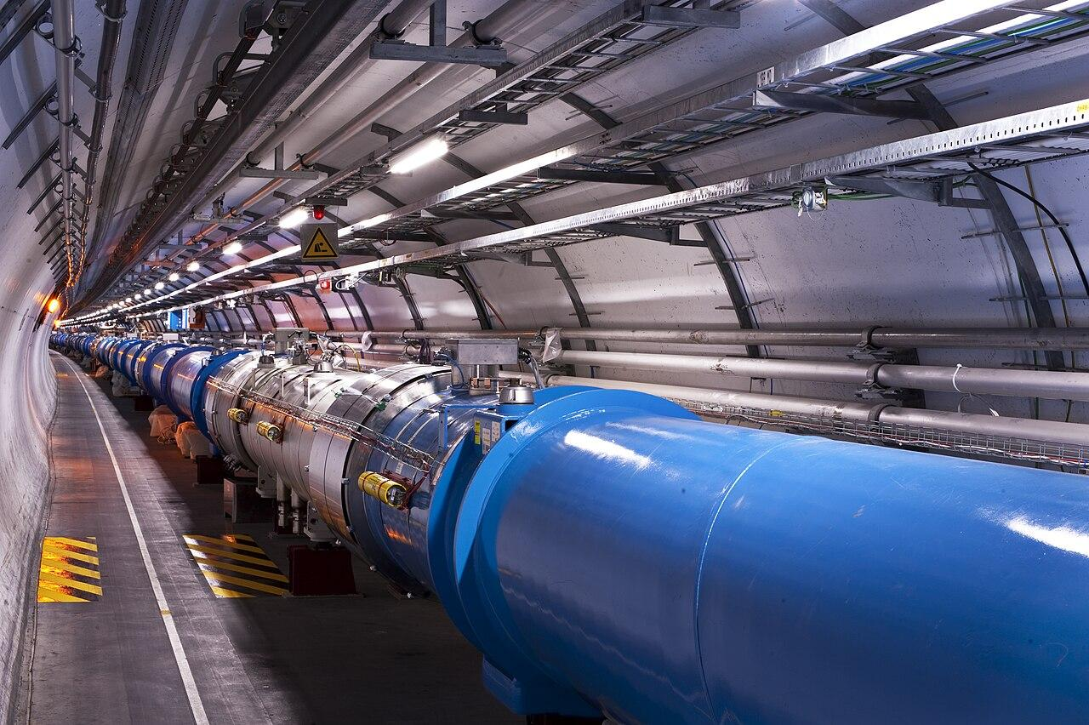
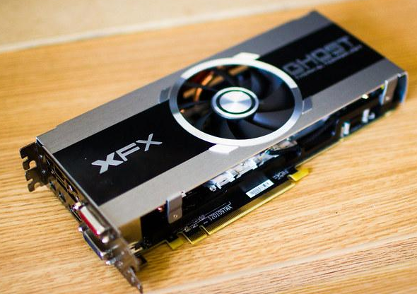
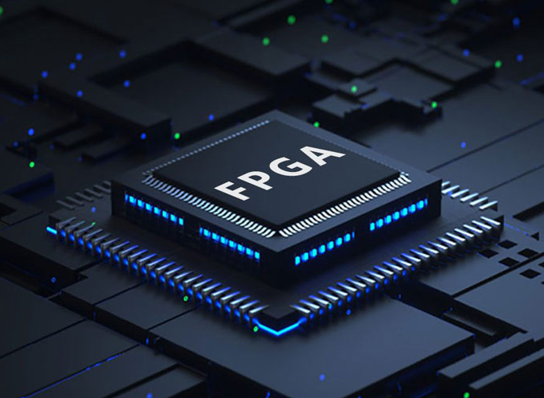
Motivation
Particle Collider
Particle Jet
Data
Notes:
Particle transformers generate huge amounts of data but all we are really interested in is what particles were created.
So we use Machine Learning to get just that data. Currently using expensive, power-hungry GPUs and our project is to migrate the ML algorithms to FPGAs that are cheaper and more power-efficient

Slide 3

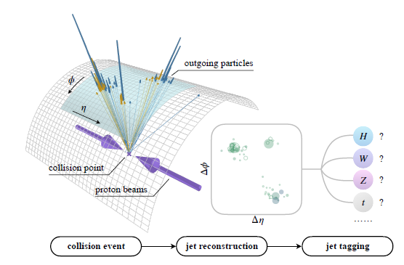
What are we doing?
DeepSoCFlow
Notes:
There's an existing model for this called the Particle Transformer that we are migrating to QKeras in order to reduce the number of model parameter and reduce the precision to save space. Then we are going to port the model onto an FPGA using a library called DeepSOCFlow and to run it.

